Slide 1
EE 295
TechWriting-Engineering Ethics
Sep 26, 2019
Room E339
Tom Wrappe
EE Lecturer

Slide 2
Agenda
Housekeeping—Schedule modifications and makeup class
Followup on Midterm Items
Feedback on Topic Descriptions
Abstract/Outline Assignment
Market Research and Citations
Virtue Ethics: The Ethics of the Person
Case Group Discussion
Challenger Disaster Intro

Slide 3
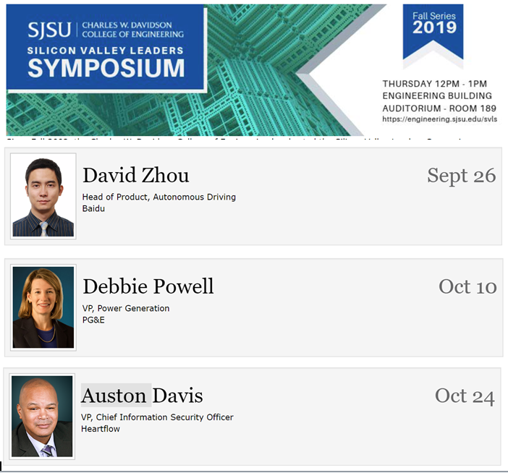
Extra Credit Opportunity: Attend Silicon Valley Leaders Symposium
https://engineering.sjsu.edu/our-college/events/silicon-valley-leaders-symposium

Slide 4
Extra Credit Opportunity
-Up to 10 Total points applied to In-Class Grade
-Attend one of three presentations and provide 300 word writeup (ONLY ONE EXTRA CREDIT; identify in the title of your submission)
-Total points available
-Up to 7 points for informational writeup (from video or in person)
-Total of 10 available for in person attendance (requires submission of code received at the seminar-be there a bit early to avoid being “closed out”)
-Post per instructions on Canvas by assigned due date

Slide 5
Makeup Class for Missed Sep 24, 2019 Session
Makeup Class Options for team (to be finalized by EE dept):
Choices---
-4:30 pm Wed, Oct 2
-6:00 pm Wed, Oct 2
-7:30 pm Wed, Oct 2
To be clear, Class will be Tu (Oct 1), W (Oct 2), and Thu (Oct 3) if cleared by Saturday, Sep 28 (note to be sent via Canvas Announcement). If not cleared by Sep 28, makeup class will be held at a future Wed at a location to be announced via Canvas

Slide 6
Fair Warning
-In Class writing exercise within next two weeks (now down to Oct 1 or 3)
-May be at BEGINNING of class with 30 min allowed INCLUDING Instructions (which begin promptly at 4:30pm or 7:30pm)
-Attend your own section unless granted permission at least 24 hours in advance

Slide 7
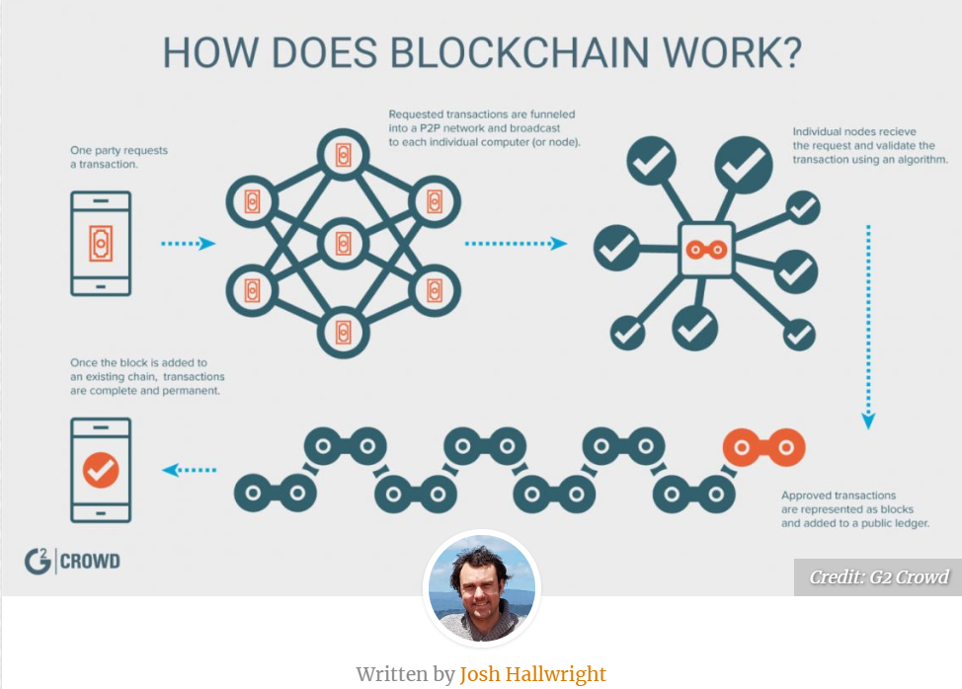
BlockChain “Gadget Descriptions in Grading Process”
To be completed with feedback before Midterm Draft Exercise

Slide 8
Semester Major Items…..(subject to modification)
 | Mid Term | Resume | Final Paper | Final Presentation (slides )
Topic Paragraph | 9.5.19
Topic Proposed | 9.12.19 |  | 10.3.19
Topic Final | 9.19.19 |  | 10.10.19
Outline/ Abstract | 9.26.19 |  | 10.31.19
Research | 10.1.19 | 10.24.19 (Class) | 10.15.19
Draft Complete | 10.10.19 |  | 11.7.19 | 11.19.19
Final Submit | 10.22.19 | 11.14.19 | 11.26.19 | 12.3.19
Final Presentation | NA | NA | NA | 12.17.19 (Sect 1) 12.12.19 (Sect 2)

Slide 9
Midterm: First 5 Page Report
The First 5 Page Report will be a Proposal/Business Plan focused on adding a new product to the product line or entering a new area
-Target audience is “your boss” who wants to get the project approved
-Arm her/him with the convincing approach and supporting facts to get the project moving
-Topic areas suggested, but specific paper topic should be put forth by the student
Submit candidate topic writeup (600 words) for approval by Sep 12 (Approval Comments provided via Canvas by Sep 19)
Develop interim deliverables per Canvas schedule
Scheduled final submission is Oct 22

Slide 10
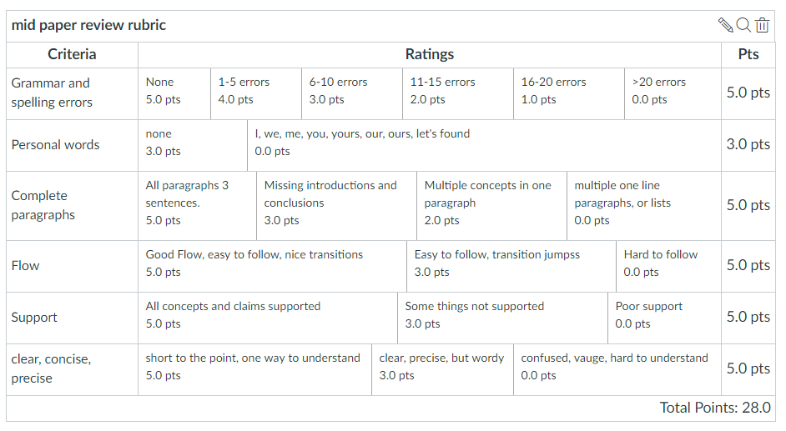
Midterm Paper Rubric

Slide 11
A Progressive Process
Step | Due | Notes
Discuss a topic | 9.5.19 | 1 paragraph on end product (Bring to Class)
Propose a topic/ company | 9.12.19 | 600 words overview of the paper (Turnin)
Abstract/Outline | 9.26.19 | Skeleton of the paper
Research Deliverable | 10.1.19 | Support Element
Draft | 10.10.19 | Complete paper, but needing edit
Final Submission | 10.22.19 | Final product

Slide 12
Midterm-Related Abstract/Expanded Outline
Submit an abstract and a summary outline of the 5-page Midterm Business Proposal
1. Expand on your topic selection
-”Fine tune” your topic
-Create an outline based on the 8 sections of the example (Abstract, Exec Summary, etc....). The Proposed Product is…/The Product is safe and useful because……
2. Prepare one or two full paragraphs (not bullet items, full sentence-based paragraphs) that capture the key elements of each section. UNDERLINE THE TOPIC SENTENCE OF EACH PARAGRAPH.
Begin your market and technology research
-Identify at least 3 market sources for your market research
-Identify at least 2 potential product/technology competitors to your proposed product
3. Provide a “budget” totaling 2800-3000 words –not including the references section--for your “5 Page” Midterm paper (How will you spend your budget on each section of the outline?)
4. Attach Self-Grading Sheet: 1. Word count/topic sentence underline 2. Grammar
As always, 15% plagiarism or less is required from Turnitin

Slide 13
Outline of a Business Plan
(0) Abstract
(1) The Executive Summary
The Proposed Business Concept (Product Description)
Research and Analysis
-Market Analysis: How large is the market for this product?
-Competitive Analysis: How this product compares to others in area
Finance and Economics
Management Team
Summary of Risks and Assumptions
Conclusions and Recommendations

Slide 14
First 5 page Proposal A Concise version of a Business Plan
Outline | Outline/ Abstract | Draft (5 pages) | Midterm paper (5 pages) | Final Paper ? 15 pages
1. Abstract | Paragraph | ½ page max | ½ page max
2. Executive Summary | paragraph | ½ to 1 page | ½ to 1 page
3. Product Description | 2 paragraphs or so | 1-3 pages
4 Mkt Research and Analysis | 1-2 paragraphs (5 sources min) | 1-3 pages | Depends on sources
5. Finance and Economics | Short paragraph | ½ to 1 page
6. Management Team | Short paragraph | ½ page
7. Risks and Assumptions | Short paragraph | ½ page
8. Conclusions and Recommendations | Short paragraph | ¼ to ½ page
A. Sources | Not Applicable | ½ to 1 page | ½ to 1 page
The outline endures while the content grows

Slide 15
Midterm-Research Assignment For Oct 1:
More sources are better, but perform research on your market and product. Identify each reference source in full IEEE Reference Format followed by a descriptive paragraph :
-Identify at least 3 market sources for your market research and write a paragraph for each source identifying the key information the source provides for the paper.
-Identify at least 2 potential product/technology competitors to your proposed product and contrast them with your product and write a paragraph for each source identifying the key information the source provides for the paper.
Provide a Self Grading Sheet with the following confirmations:
a. Word Count (not applicable, no word limit or minimum, but provide 5 good paragraphs)
b. UNDERLINE THE TOPIC SENTENCE IN EACH PARAGRAPH
c. Grammar checklist: a. No personal pronouns, b. No passive voice, c. no use of "very", d. Complete paragraphs with topic sentence, supporting sentence(s) and conclusion sentence
d. As always, 15% plagiarism or less is required from Turnitin (quote your sources in IEEE format . (See http://sites.ieee.org/pcs/transactions-of-professional-communication/for-prospective-authors/guidelines-to-follow/guidelines-for-preparing-references)

Slide 16
Midterm Research Submission
Descriptive Title with proper Capitalization
Market Sizing Sources
[1] Source 1 in IEEE format
Key research information from Source 1
[2] Source 2 in IEEE format
Key research information from Source 2
[3] Source 3 in IEEE format
Key research information from Soruce 3
Competitive Product Sources
[4] Source 4 in IEEE format
Key research information from Source 4
[5] Source 5 in IEEE format
Key research information from Source 5
Self Grading Sheet
Insert Self Grading Table with confirmation for all rows ensuring that you have verified checklist items

Slide 17
IEEE Author Center
-IEEE articles and journals have a set process to provide consistency
-https://procomm.ieee.org/transactions-of-professional-communication/for-prospective-authors/guidelines-to-follow/guidelines-for-preparing-references/
-Process overview posted on Canvas (Trans_Jour template)
-Provides detail on authoring, peer review, figures, tables for professional journal and symposia submissions

Slide 18
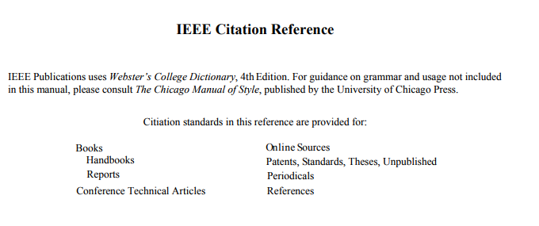
IEEE Citations (For both Midterm and Final) Wikipedia is not an acceptable source above Middle School
http://www.ieee.org/documents/ieeecitationref.pdf

Slide 19
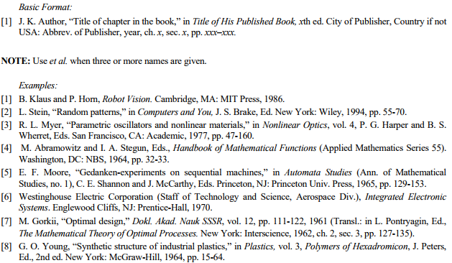
IEEE Citations
Books

Slide 20
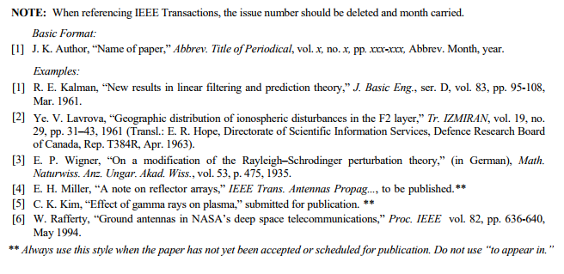
IEEE Citations
Periodicals

Slide 21
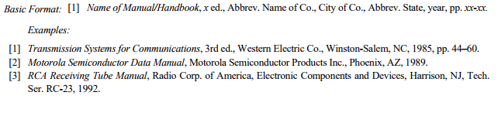
IEEE Citations
Handbooks

Slide 22
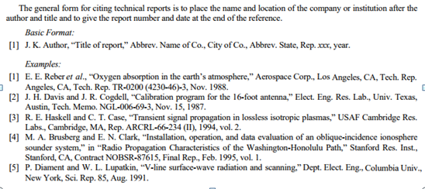
IEEE Citations
Reports

Slide 23
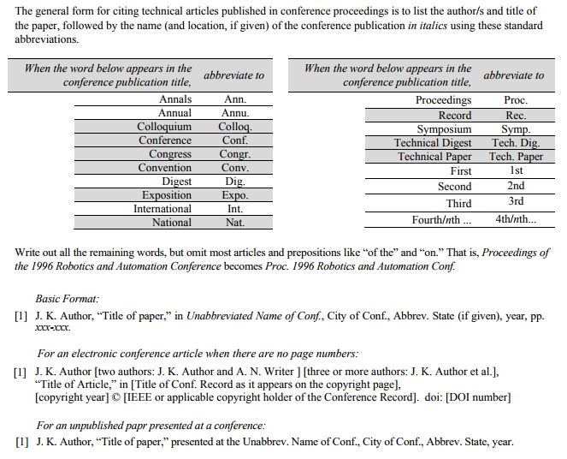
IEEE Citations
Conference Technical Articles

Slide 24
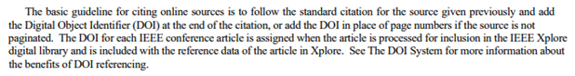
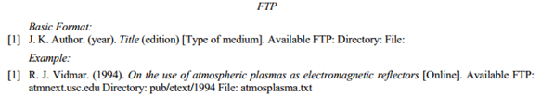
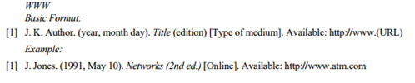
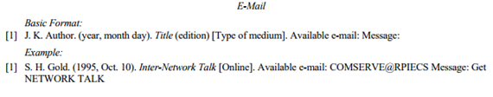
IEEE Citations
Online Sources (CONSIDER ACCESS DATES)

Slide 25
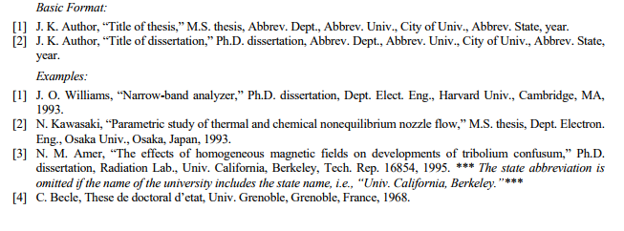
IEEE Citations
Theses and Dissertations

Slide 26
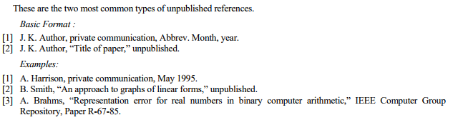
IEEE Citations
Unpublished

Slide 27
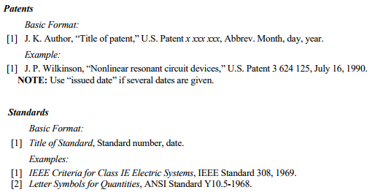
IEEE Citations
Patents and Standards

Slide 28
Virtue Ethics
Virtue Ethics
Eugene Moriarity, (2008) “Virtue Ethics, Chapter 5” in The Engineering Project, Its Nature, Ethics and Promise, Penn State Press
Tom Wrappe
EE Lecturer

Slide 29
Agenda
Ethics and Morality
The Virtuous Agent
Practice
Objectivity
Honesty
Care
Phronesis
Conclusions

Slide 30
Ethics and Morality
Virtue Ethics
Primary ethics extant from premodern engineering
Extant: Still in existence, original
Example: "the original manuscript is no longer extant"
Applicable to contemporary engineering character
Morality may be customary or reflective
Person Ethics focuses on customary, pre-reflective behavior
Reflective character forms the basis of Virtue Ethics
Moriarity proposes Virtue Ethics as a complement to, not a substitute for, Ethical analysis
Ethical theory informs moral practice---Utilitarianism, Deontology
Morality grounds Ethical analysis

Slide 31
The Virtuous (Reflective) Agent
Theories of Virtue Ethics evolve from the Agent’s vision of the “final end”
Not a structured, hierarchical approach
Seek to work out a just institution, which is Engineering in our case
Virtue forms character
Recognize certain situations as problematic
Certain factors have special weight in ethical decisions (ie, honesty, fairness..)
Concern for things considered desirable
Commitment to provide the connecting thread for a “good outcome”

Slide 32
Practice of Virtue Ethics
Good character comes from repeated practice of Virtue Ethics
Within engineering, rules-based ethics and virtue ethics tend to converge at the end decision
Virtue ethics focuses on internal development
Practice involves social interaction and interpersonal relations
Key question is how engineers can develop internal virtuosity of technical excellence while creating devices and systems that enhance society for the common good

Slide 33
Objectivity
Virtue Ethics
Objectivity is the disposition of impartiality (“remove yourself from the situation”)
Disinterested rather than uninterested approach
Fair and fully inclusive
Consider facts, beliefs and interests applicable to a situation
Set aside biases and influenced beliefs
Engineers must consider profit, but also environmental and other “costs”
Requires objectivity to not skew to preference for one and exclusion of the other

Slide 34
Honesty
Virtue Ethics
Pure honesty is to tell the truth and avoid lies despite the consequences
In engineering, honesty often involves telling the particular truth, but not necessary the complete truth
Complexity
Team pressure
Example of Challenger 1986
Managers distorted “engineering recommendation” to delay the launch received from the engineering team

Slide 35
Care
Virtue Ethics
Care for others combines with objectivity and honesty for a total Virtue Ethics “Scoring”
Connection for care is far reaching
Our team
Our community
Global

Slide 36
Phronesis and Reflective Virtue
Virtue Ethics
The activity of deliberation is called prudence, or phronesis
Deciding what is truly good for persons and groups based on objective, honest, caring perspective
Morton Thiokol engineer practiced phronesis in his recommendation of delay
Technical excellence in analysis of meager data
Concern for crew and project

Slide 37
Conclusion: Ethics of Person
Virtue Ethics
Objectivity, Honesty and Care are basic virtues
Overall virtue is weighted average of the basic variables
Application of the weighting factors is driven by phronesis of the investigator

Slide 38
Review the Larom Case
You were hired at Larom because of your promising research with catalysts as a student at SJSU.
Supervisor, Alex Smith, announces that your unit must make a recommendation within next two days on which catalyst should be used in processing a major product.
The overwhelming consensus of the engineers in your unit, based on many years of experience, is that catalyst A is best for the job.
Your research provides preliminary evidence that catalyst B might be more reliable, more efficient, and considerably less costly.

Slide 39
Review the Larom Case
You ask if the recommendation can be delayed a month to see if firmer evidence can be found.
Alex asks you to write up the report, leaving out the preliminary data about catalyst B.
He says, “we've already taken too much time on this project. … we have to be decisive--and we have to look decisive …Besides, we've had a lot of experience in this area."
You have no desire to challenge your colleagues. You don't necessarily disagree with them about which catalyst is best. BUT you wish you had been given more time to work on catalyst B and feel uncomfortable about leaving the preliminary data out of the report.
How do you rate Alex’s Virtue Ethics? : Objectivity, Honesty, Caring
What is your most ethical and practical course of action?

Slide 40
Challenger Disaster
-Virtue ethics displayed by some involved
-Ignored by others
Video Clip

